Slide 1



Course : Machine Learning
Lecture On : EDA
Instructor : Siddhesh Gunjal

Slide 2

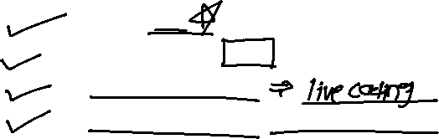
Agenda
1
What is EDA
2
Best Practices in EDA
3
Let’s see an example
4
Mini Case Study . That’s for you folks!

Slide 3
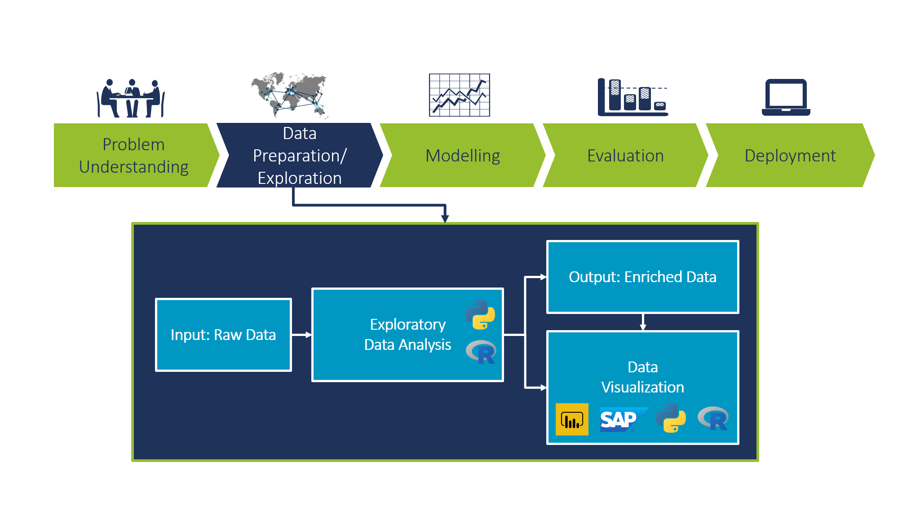
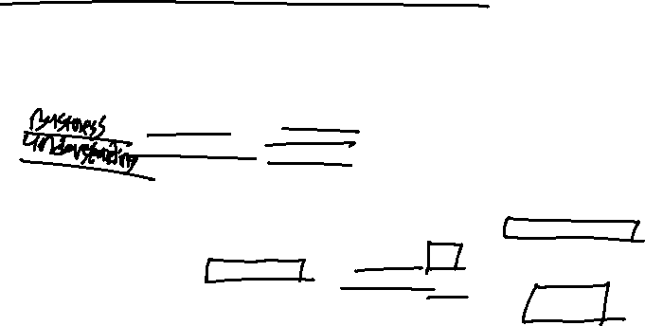
What is Exploratory Data Analysis?
Notes:
It is a good practice to understand the data first and try to gather as many insights from it. EDA is all about making sense of data in hand, before getting them dirty with it.
There are actually no shortcuts for data exploration. If you are in a state of mind, that machine learning can sail you away from every data storm, trust me, it won’t. After some point of time, you’ll realize that you are struggling at improving model’s accuracy. In such situation, only data exploration techniques will come to your rescue.
I can confidently say this, because I’ve been through such situations, a lot. To top all of that Recruiters love EDA ☺

Slide 4
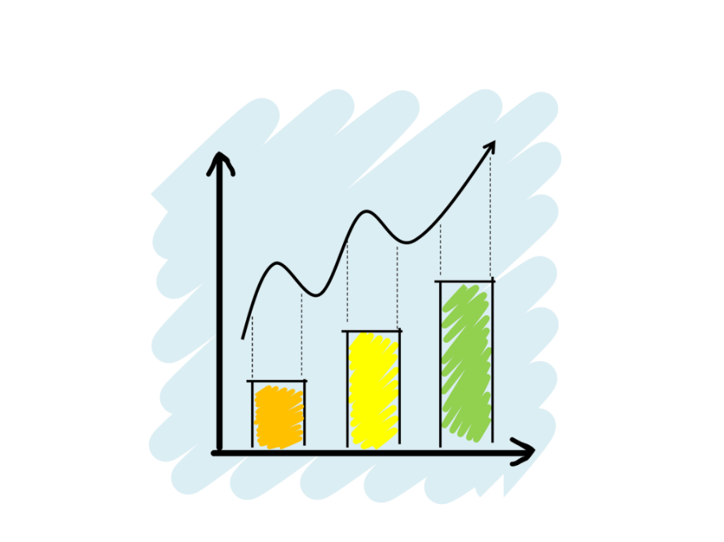
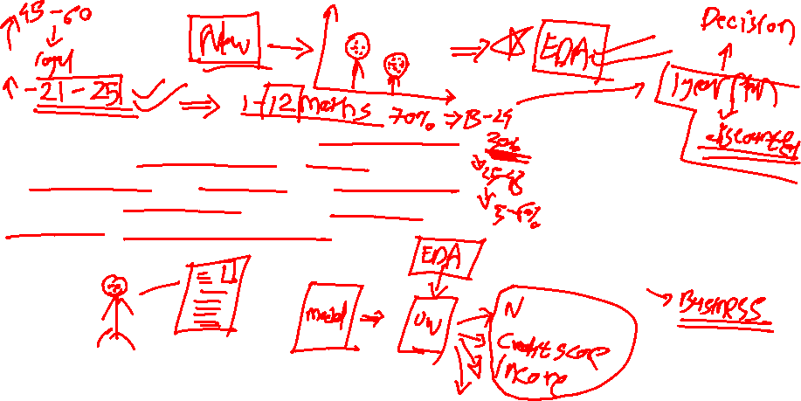
What is Exploratory Data Analysis?
“ Exploratory Data Analysis refers to the critical process of performing initial investigations on data so as to discover patterns, to spot anomalies, to test hypothesis and to check assumptions with the help of summary statistics and graphical representations.”
Notes:
It is a good practice to understand the data first and try to gather as many insights from it. EDA is all about making sense of data in hand, before getting them dirty with it.
There are actually no shortcuts for data exploration. If you are in a state of mind, that machine learning can sail you away from every data storm, trust me, it won’t. After some point of time, you’ll realize that you are struggling at improving model’s accuracy. In such situation, only data exploration techniques will come to your rescue.
I can confidently say this, because I’ve been through such situations, a lot. To top all of that Recruiters love EDA ☺

Slide 5

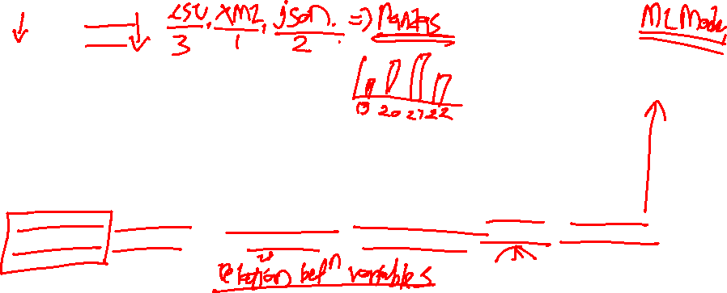
Fundamental steps of EDA process
Collect Insight /
ML model training
https://www.researchgate.net/publication/342282008_Exploratory_Data_Analysis_and_Data_Envelopment_Analysis_of_Construction_and_Demolition_Waste_Management_in_the_European_Economic_Area

Slide 6
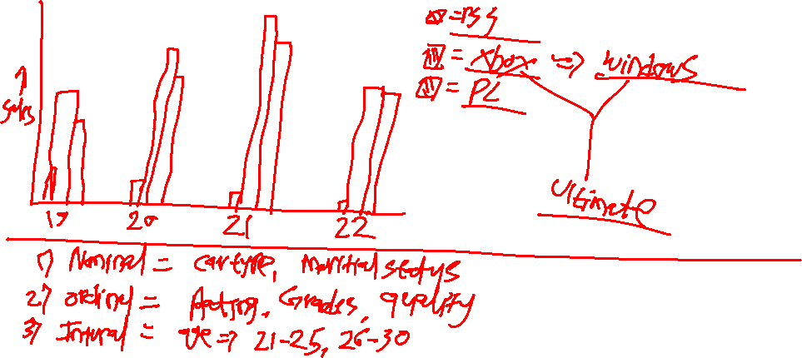

Slide 7
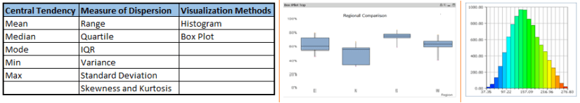
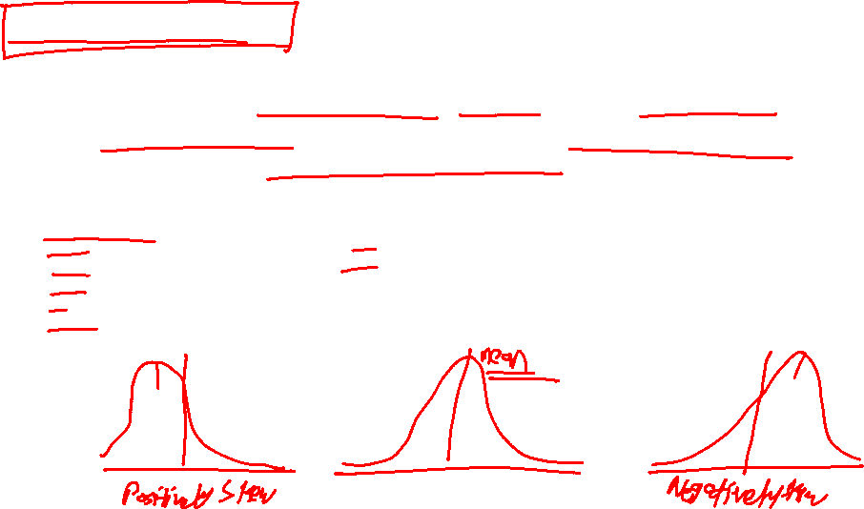
Univariate Analysis
At this stage, we explore variables one by one. Method to perform univariate analysis will depend on whether the variable type is categorical or continuous.

Slide 8
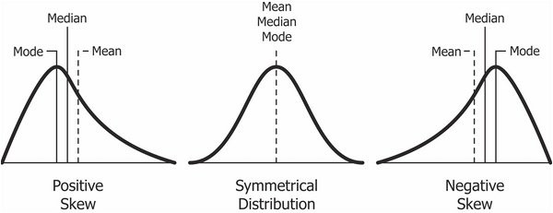
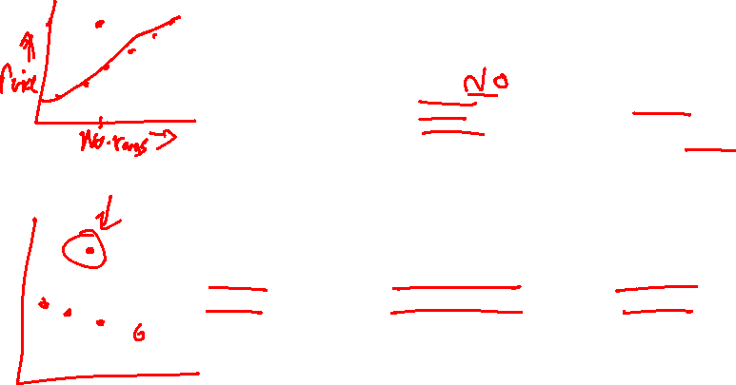
Univariate Analysis

Slide 9




Poll
Please select the plots which could be used for univariate analysis
Histogram
Correlation matrix
Box-plot
Scatter plot
20-08-2022
11

Slide 10

Poll - solution
Please select the plots which could be used for univariate analysis
Histogram
Correlation matrix
Box-plot
Scatter plot
20-08-2022
11

Slide 11
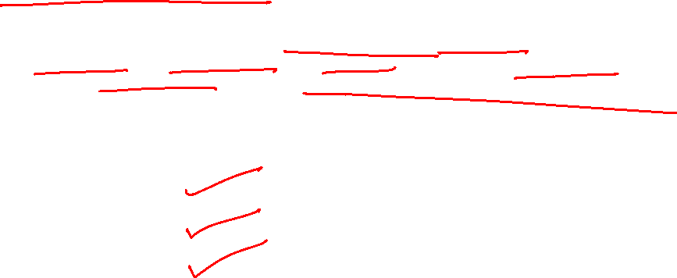
Bi-variate Analysis
Bi-variate Analysis finds out the relationship between two variables. Here, we look for association and disassociation between variables at a pre-defined significance level. We can perform bi-variate analysis for any combination of categorical and continuous variables.
The combination can be:
Categorical & Categorical
Categorical & Continuous
Continuous & Continuous.

Slide 12
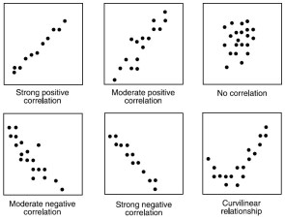
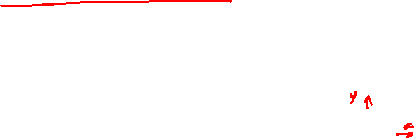
Continuous vs continuous
While doing bi-variate analysis between two continuous variables, we should look at scatter plots. It is a nifty way to find out the relationship between two variables. The pattern of scatter plot indicates the relationship between variables. The relationship can be linear or non-linear.

Slide 13
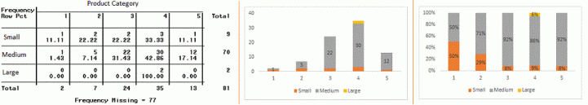
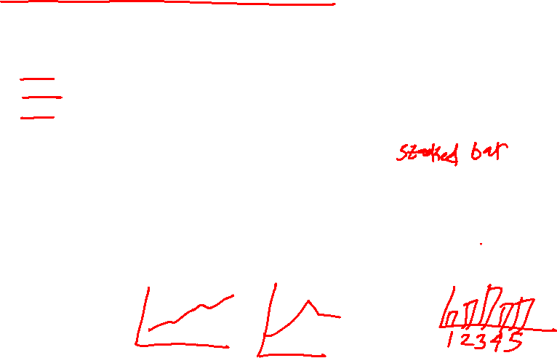
Categorical & Categorical
Two-way table: We can start analyzing the relationship by creating a two-way table of count and count%. The rows represents the category of one variable and the columns represent the categories of the other variable. We show count or count% of observations available in each combination of row and column categories.
Stacked Column Chart: This method is more of a visual form of Two-way table.

Slide 14
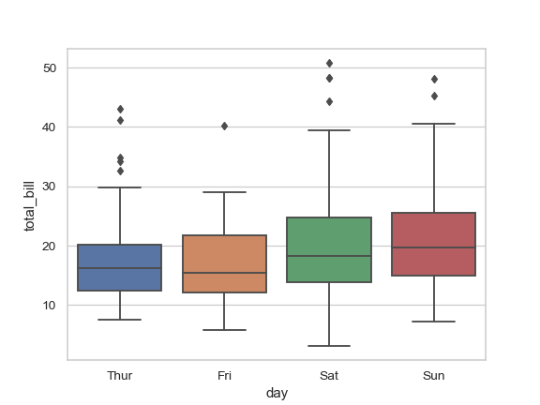
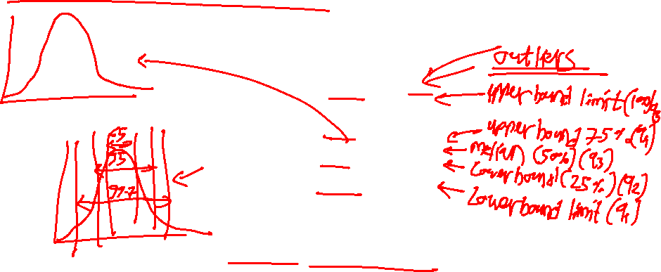
Categorical & continuous
While exploring relation between categorical and continuous variables, we can draw box plots for each level of categorical variables

Slide 15
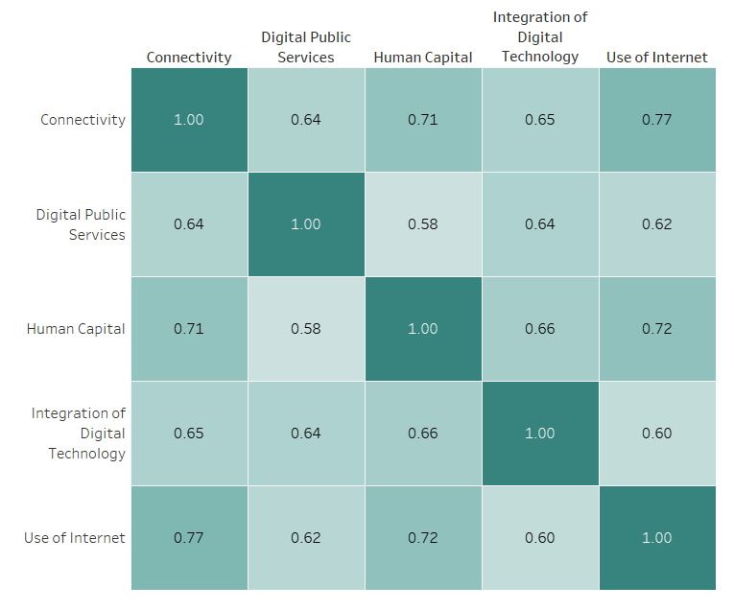
Poll
Poll 1
Please select a category which would lead to highest improvement in “Integration of Digital Technology” category?
Use of internet
Human Capital
Connectivity
Digital public services
20-08-2022
11

Slide 16
Poll
Poll 1
Please select a category which would lead to highest improvement in “Integration of Digital Technology” category?
Use of internet
Human Capital
Connectivity
Digital public services
20-08-2022
11

Slide 17
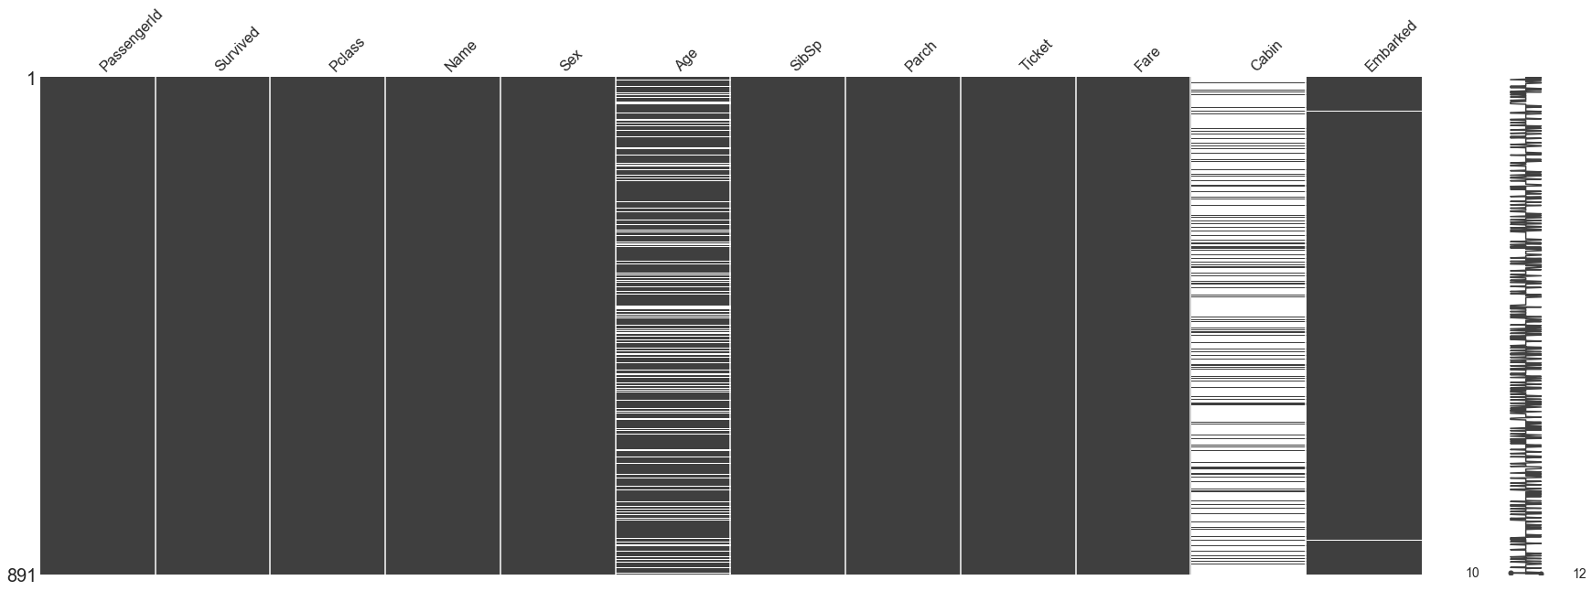

Missing Value Treatment
Data Extraction: It is possible that there are problems with extraction process. In such cases, we should double-check for correct data with data guardians. Some hashing procedures can also be used to make sure data extraction is correct. Errors at data extraction stage are typically easy to find and can be corrected easily as well.
Data collection: These errors occur at time of data collection and are harder to correct. They can be categorized in four types:

Slide 18

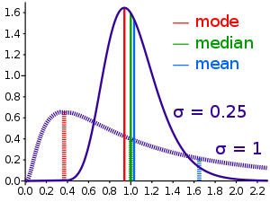
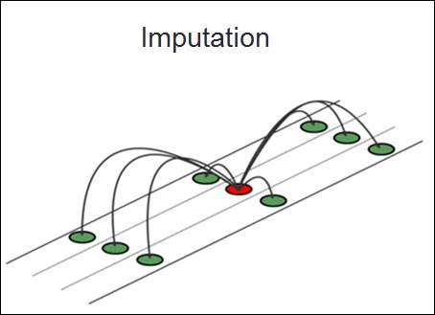

Methods to treat missing values
Data – deletion Deletion methods are used when the nature of missing data is “Missing completely at random” or we have good amount of data and the data loss would be really low ,else non-random missing values can bias the model output
Mean/ Mode/ Median Imputation Mean / Mode / Median imputation is one of the most frequently used methods. It consists of replacing the missing data for a given attribute by the mean or median (quantitative attribute) or mode (qualitative attribute) of all known values of that variable.
Prediction Model we create a predictive model to estimate values that will substitute the missing data. In this case, we divide our data set into two sets: One set with no missing values for the variable and another one with missing values. First data set become training data set of the model while second data set with missing values is test data set and variable with missing values is treated as target variable.

Slide 19

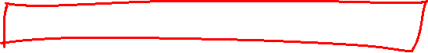
Tell me the Disadvantages of KNN-Imputation.

Slide 20


KNN algorithm is very time-consuming in analyzing large database. It searches through all the dataset looking for the most similar instances.
Choice of k-value is very critical. Higher value of k would include attributes which are significantly different from what we need whereas lower value of k implies missing out of significant attributes.

Slide 21
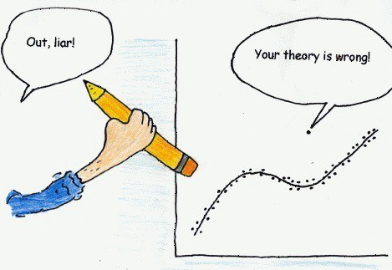

Outlier Detection and Treatment
Outliers can drastically change the results of the data analysis and statistical modeling. There are numerous unfavorable impacts of outliers in the data set
Notes:
Outlier is a commonly used terminology by analysts and data scientists as it needs close attention else it can result in wildly wrong estimations. Simply speaking, Outlier is an observation that appears far away and diverges from an overall pattern in a sample.

Slide 22
Poll
Which of the measures will be affected significantly in case of an outlier?
Mean
Median
Mode
Standard Deviation
20-08-2022
11

Slide 23
Poll
Which of the measures will be affected significantly in case of an outlier?
Mean
Median
Mode
Standard Deviation
20-08-2022
11

Slide 24
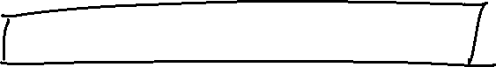
What all methods can you use to treat outliers?

Slide 25
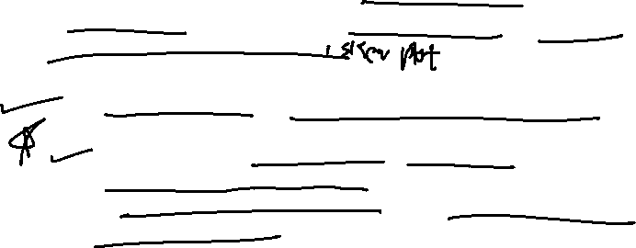
Most commonly used method to detect outliers is visualization. We use various visualization methods, like Box-plot, Histogram, Scatter Plot
Some thumb rules to automatically detect outliers are :
Any value which out of range of 5th and 95th percentile can be considered as outlier
Three or more standard deviation away from mean are considered outlier

Slide 26
Poll Questions
Question-1: What is the mean NA_Sales?
●
●
●
0.2
0.1
0.07
Question-2: What is the percentage of missing values for Critic_Score?
50%
30%
40%
Question-3: What is the change is the percentage of missing values after we dropped rows where Name was missing?
●
●
●
1%
0.1%
0.01%

Slide 27
Poll Questions
Question-4: What is the Critic_Score at 90th percentile?
80
85
90
Question-5: What is the number of observations where the score_pre_critic is 3?
50
40
70
Question-6: Plot the Global Sales variable and check if the data is skewed? Is the data highly skewed?
Yes, The data is highly skewed
No, The data is normally distributed

Slide 28
Poll Questions
Question-7: Plot the critic score, is the data normally distributed?
Yes
No
Question-8: Plot the user score, is the data left skewed or right skewed?
●
●
Left Right
Question-9: Plot year of release variable, which year we have the maximum releases?
●
●
●
2008
2010
2003

Slide 29
Poll Questions
Question-10: Plot the platform variable, which platform looks most popular?
PS2
PS3
PSP
Question-11: Plot the genre variable, which is the most popular genre?
Sports
Action
Racing
Question-12: Plot a correlation plot, check how user and critic score are related to each other?
Positive
Negative
No Correlation

Slide 30
Poll Questions
Question-13: Plot to check which gener sold the most in the global market according to the global sales?
●
●
●
Racing Action Sports
Question-14: Who is the top publisher with respect to the global sales?
EA
Ubisoft
Nintendo
Question-15: Who is the top publisher with respect to the number of release?
EA
Ubisoft
Nintendo

Slide 31
Poll Questions
Question-16: Which is the most profitable game of all time?
Super Mario Bros
Tetris
Wii Sports
Question-17: Which game is the most popular game in the Action genre?
Grand Theft Auto V
Grand Theft Auto IV
Grand Theft Auto: San Andreas

Slide 32

#LifeKoKaroLift
Thank You!

